Slide 1


DATA STRUCTURES USING C Lecture 5
Prof. P. S. Avadhani
M. Tech., PhD., F.I.E,FCSI, FAPAS.
Visiting Professor, Central University of Odisha
Former Director, IIIT, Agartala
Former Principal, AU College of Engg,
Andhra University, Visakhapatnam

Slide 2
Binary Search

Slide 3
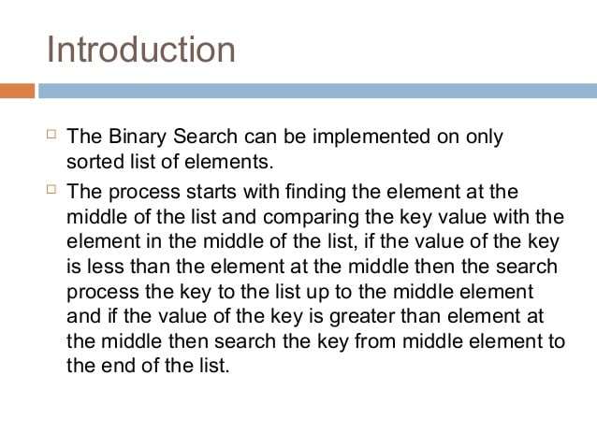

Slide 4
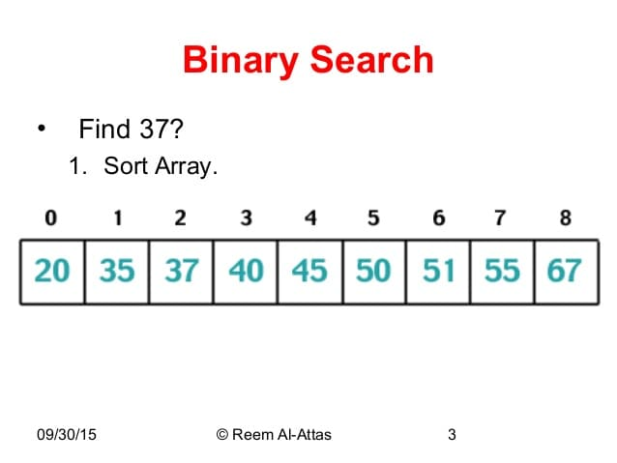
Sort the arrary if it is not already sorted

Slide 5
Calculate middle = (low+high)/2 = (0+8)/2 = 4
Array[middle] = arrary[4] = 45. The key 37 is less than 45 so remove the upper half form 45. set high = middle-1 = 3. Now we need to check from 0 to 3.

Slide 6
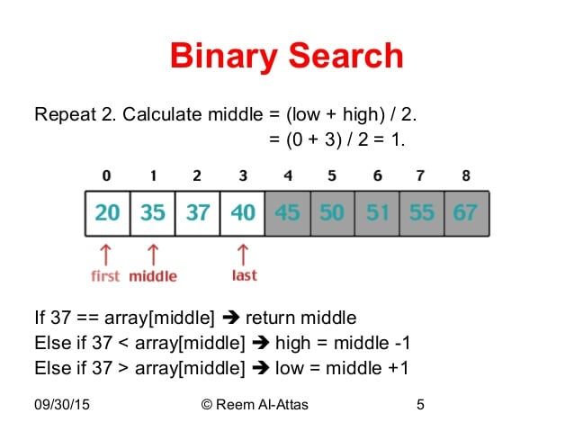

Slide 7
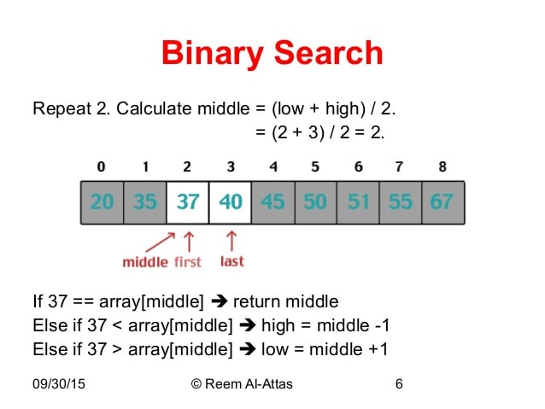

Slide 8
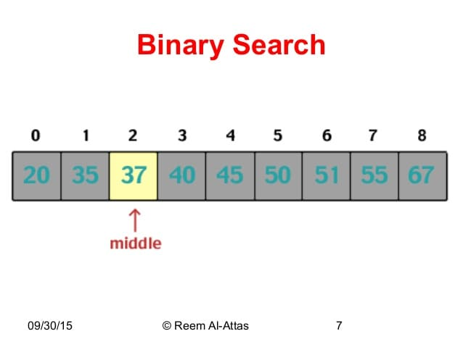

Slide 9
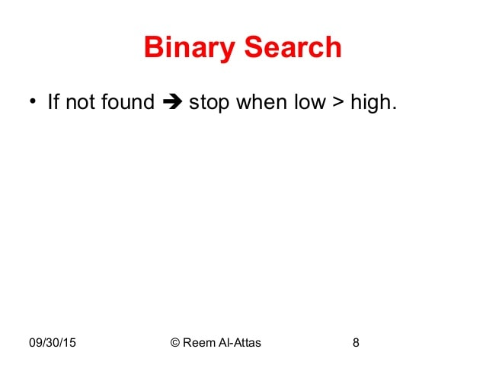

Slide 10
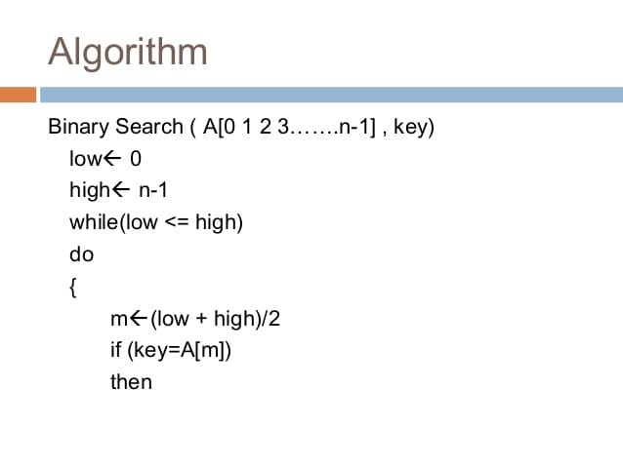

Slide 11
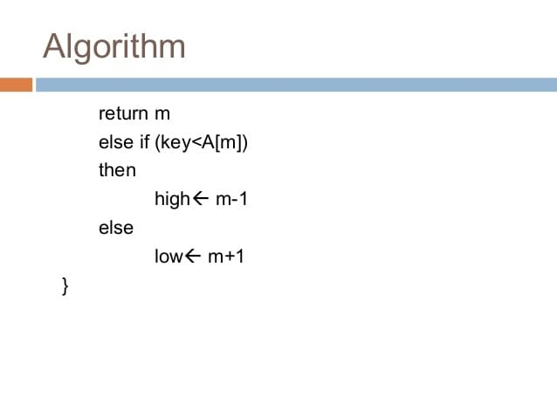

Slide 12
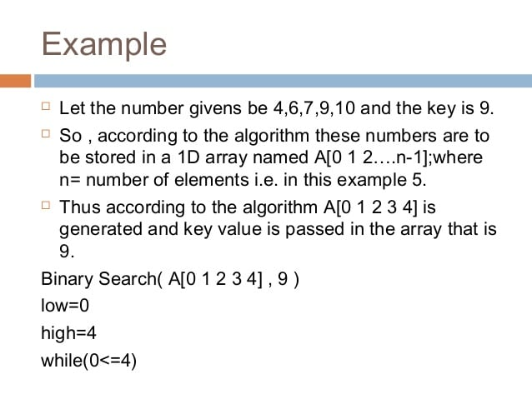

Slide 13
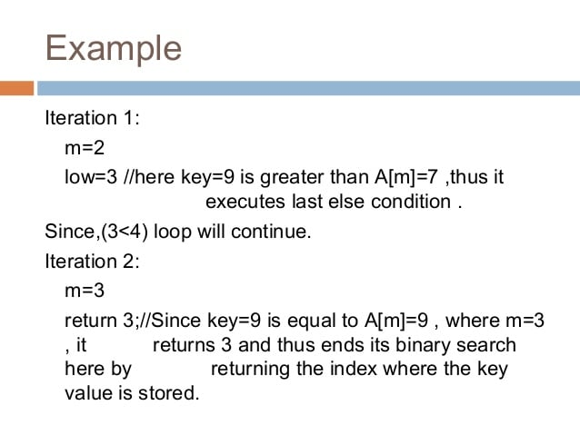

Slide 14
* Write a C program to accept N numbers sorted in ascending order and to search for a given number using binary search. Report sucess or fialure in the form of suitable messages*/
#include <stdio.h>
#include <conio.h>
void main()
{
int array[10];
int i, j, N, temp, keynum, low,mid,high;
clrscr();
printf("Enter the value of N\n");
scanf("%d",&N);
printf("Enter the elements one by one\n");
for(i=0; i<N ; i++)
{
scanf("%d",&array[i]);
}
printf("Input array elements\n");
for(i=0; i<N ; i++)
{
printf("%d\n",array[i]);
}

Slide 15
/* Bubble sorting begins */
for(i=0; i< N ; i++) {
for(j=0; j< (N-i-1) ; j++) {
if(array[j] > array[j+1]) {
temp = array[j];
array[j] = array[j+1];
array[j+1] = temp;
}
}
}
printf("Sorted array is...\n");
for(i=0; i<N ; i++)
{
printf("%d\n",array[i]);
}

Slide 16
printf("Enter the element to be searched\n");
scanf("%d", &keynum);
/* Binary searching begins */
low=1;
high=N;
do
{
mid= (low + high) / 2;
if ( keynum < array[mid] )
high = mid - 1;
else if ( keynum > array[mid])
low = mid + 1;
} while( keynum!=array[mid] && low <= high); /* End of do- while */
if( keynum == array[mid] )
{
printf("SUCCESSFUL SEARCH\n");
}
else
{
printf("Search is FAILED\n");
} /* End of main*/

Slide 17
Output
Enter the value of N
4
Enter the elements one by one
3
1
4
2
Input array elements
3
1
4
2
Sorted array is...
1
2
3
4
Enter the element to be searched
4
SUCCESSFUL SEARCH

Slide 18
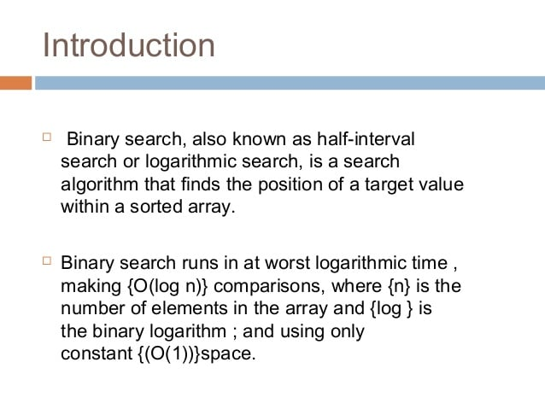

Slide 19
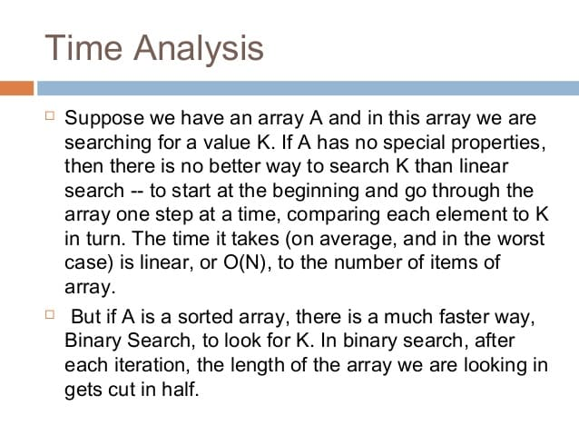

Slide 20
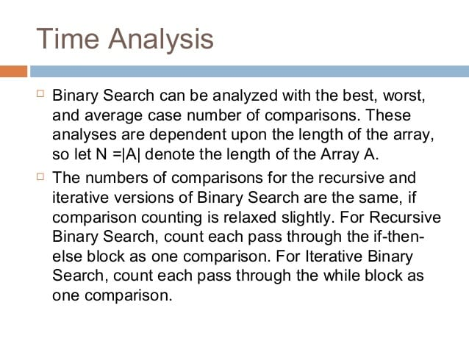

Slide 21
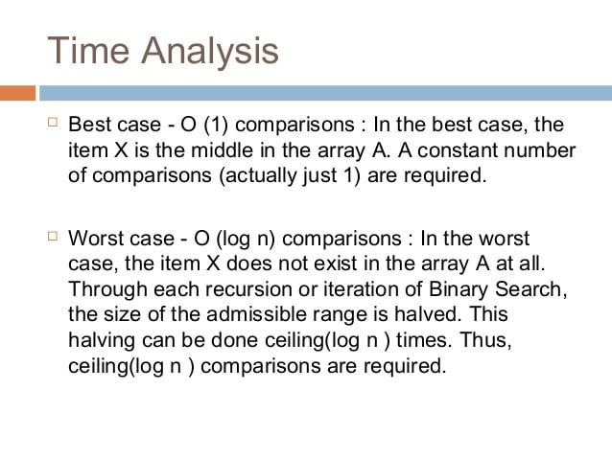

Slide 22
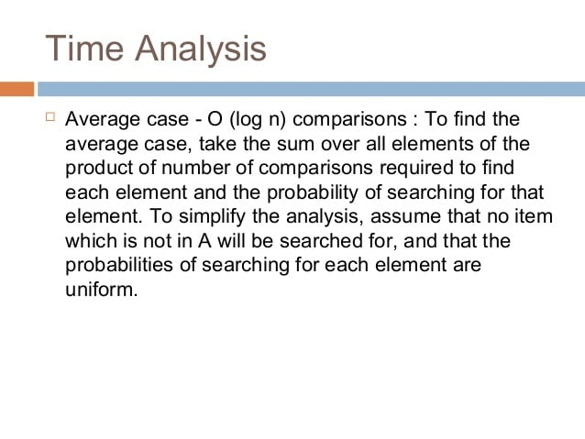

Slide 23
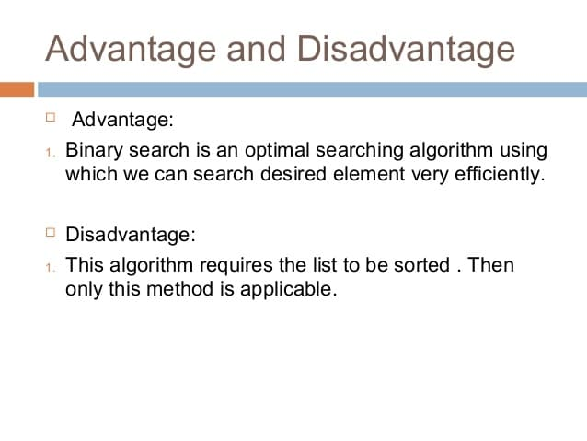

Slide 24
THANK YOU

